Slide 1
Test Automation In A Networking World
Network Automation Summit, Interop 2020
Nick Keating
Telstra
https://www.linkedin.com/in/nicholaskeating/
Chi Sherriff
Telstra
https://www.linkedin.com/in/chi-sherriff-09a94112/

Slide 2
Who Are We?
  Nick Keating – Network Engineer - Telstra, Australia
  Chi Sherriff – Network Engineer - Telstra, Australia
What We do?
  Dedicated ‘Testing Services’ business unit focused on testing Network protocols
  and Topologies. Historically manual with a shift to automation in the last 3 years.
Disclaimer
  We are still relatively new in our automation journey. We are by no means speaking as experts, but from a position of our own experience and learning.

Slide 3
Purpose
Network testing is expensive
We run a large-scale lab (medium sized ISP equivalent).
Large expense to purchase and run the equipment (power, cooling, maintenance etc.).
Testing goal is to find defects (software, design, architecture). Forces delays and retesting.
Good Automation candidate.
Automation Tools
    Tools and concepts in abundance.
    Most implementations focus on network operation (deployment, upgrades, config management).
    Google Test Automation. Very ‘software engineering’ focused (unit testing, API testing, frontend testing etc.).
Automation Principles
    The application of the same automation principles varies between production network and lab/testing network environment.
    The lack of information in the community with regards to this was a challenge for us.
    How some of these automation principles have helped us achieve our design goals.
Notes:
Lab hardware purchase, running, upgrade and maintenance is a large overhead cost with a hard to quantify ROI. Virtualisation can help but a lot of bugs we find are hardware related and therefore bare metal is preferred.
The goal of testing is to find defects in the architecture, overall design, vendor software/hardware (interop a big problem)
This causes delays to deployment due to defect fix and then requirements to re-test.
This is why it is a great candidate for automation, to lower the time it takes and costs associated with the testing phase of a networking project, to lower our time to market ability without risking the quality of the product.
Open source and proprietary Automation tools and concepts are in abundance, but their use in the industry and community seem to nearly entirely focused on their implementation in the network operation space.
If you google Test Automation for help, advice or even Jobs, just about all you will find is information about test automation in a software engineering world. A lot of automation of Unit testing, API testing, Web page and front end testing etc. But basically nothing in the world of Network Testing and automating this critical task.
The purpose of this talk is to address these points. To put some of the experience, learnings and information that we have found useful out to the community to help anyone trying to do a similar thing. Our aim is to do this by addressing some of the key principles of Network Automation, how we have aimed to implement them in our Test Automation Framework and how this implementation may differ from a conventional Network operation deployment.
We will then aim to describe how these principles and their implementation have helped us to answer (and continue to answer) the major questions and design goals that we aimed to address in building a network test automation framework from scratch.

Slide 4
Outline
Our Design Goals:
How do we lower cost and shorten time of test programs without jeopardising testing quality?
For a large-scale lab that services many networks, different vendors and different types of testing, how do we address this?
How do we make the developed code re-usable?
How do we implement such a system in an environment where multiple manual test programs are using the same network devices at the same time as automation?
How do we automate the entire testing workflow, not just the execution?
How do we accommodate the nature of test topologies that constantly change?
Automations Principles:
Inventory
Source of truth
Modularity
Structure
Reservation + Scheduling

Slide 5
Automation Principles INVENTORY

Slide 6
Inventory
Production vs Lab
Our inventory
The goal is to have enough flexibility to update our inventory to capture the rapid changes in the lab.
Can not be set and forget, needs to be able to account for the constant lab changes to ensure accuracy of the source of truth.
Current implementation updates every hour. All devices managed by the Automation Framework are re-discovered and inventory is updated accordingly.
Ideal future implementation is to have the changes trigger an auto-discovery and inventory update (telemetry)
Production Environment
    Changes are strictly controlled
    Rate of change of hardware and software versions is slow
Our Lab Environment
    Changes occur frequently with minimal control
    Hardware removed/replaced (Multiple times a day)
    Software changes occur weekly, multiple platforms with a combination of software levels.

Slide 7
Automation Principles SOURCE OF TRUTH

Slide 8
Test Case Source Of Truth
Test Case Source of truth – More than just an inventory
Aim to automate the entire testing workflow, not just the execution phase.
Test Topology Selection, Allocation & Reservation
End-to-End test service configuration across all devices in topology
Shakeout of test services using IXIA protocol and traffic configuration
Execution of all test cases in the suite
Removal/clean up of test topology and release reservation
Results Logging
Network State Data
TEST CASE SOURCE OF TRUTH
Inventory Data
Inventory Data and test case input data
Notes:
Some major benefits:
Allows customer simulation for all verifications (not often required in production frameworks)
Extremely important in our space, must go beyond just configuring the network.
Being able to configure Traffic Generators, CPEs etc. Verify the protocols will establish (e.g. Same IP subnet at each end, built on the correct VLANs etc.)
Snapshot of environment and validate test conditions (each test case)
Snapshot of all device facts and shakeout of test topology possible for every test case. Time consuming to do manually.

Slide 9
Automation Principles MODULARITY

Slide 10
Modularity
The key to re-usability
    Focus not on creating a test cases but rather to build reusable functions that create test conditions and verify the result.
    Consistent function design to cater for different operating systems and commands.
    Keyword driven architecture (more in next section), provides a consistent frontend.
    Need consistent data structure output from operational commands.
    Provides the tester with flexibility to customize test conditions and validation - No two testers test the same way

Slide 11
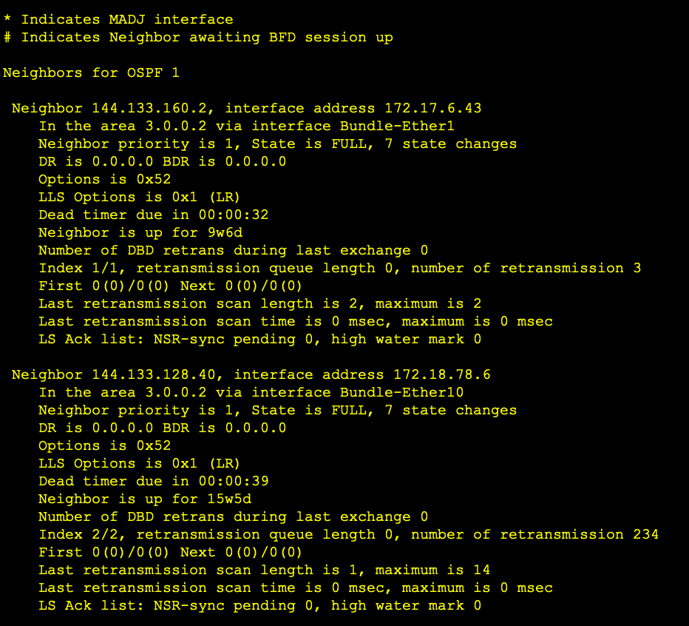
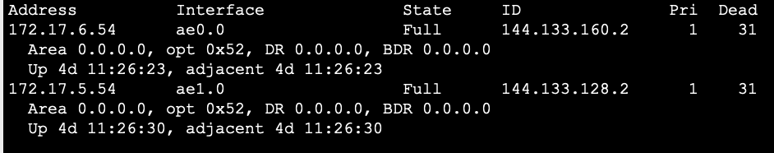
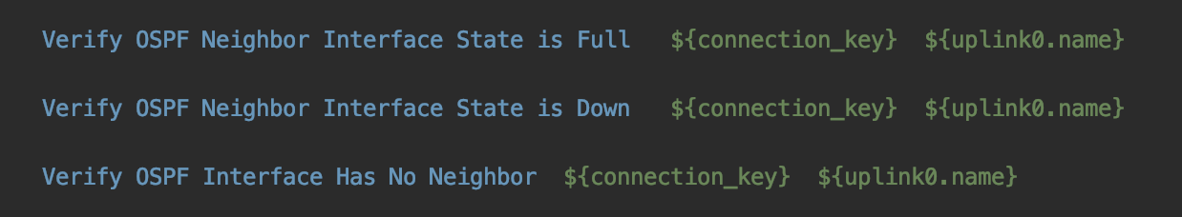
Modularity
The key to re-usability
Different operational commands and outputs across vendors with no standardised structured data output across the board – One of our biggest challenges
“show ospf neighbor detail”

Slide 12
Modularity
The key to re-usability
We need a consistent structured output
    Find ways to present the various forms of cli output as structured data in a more uniform way.
    Build an interface to transform CLI output from various vendors to a common data structure.
    This is a well-known concept in network automation, however for network test automation the focus is on operational commands (status of network elements).
    There is a large variety of commands that will produce the output required.
    The idea is to select the operational commands (and the relevant information from them) that will meet the test validation criteria as well as be available across all the vendors and platforms in scope.
We are still working at finding a better solution for this everyday!!

Slide 13
Automation Principles STRUCTURE

Slide 14
Test Case Structure
Robot Framework – Why?
The best fit for us at the time
    Keyword driven architecture that meets our modularity requirements.
    Keyword functions read like an English sentence - An easy transition from writing tests steps in test documents to Robot files.
    Clear inbuilt test case logging and captures, good visual presentation, good data presentation.
    Provide result output as xml and html that can be further processed by other tools.
    We use robot as a front end only. All complexity is handled by the backend supported python functions.

Slide 15
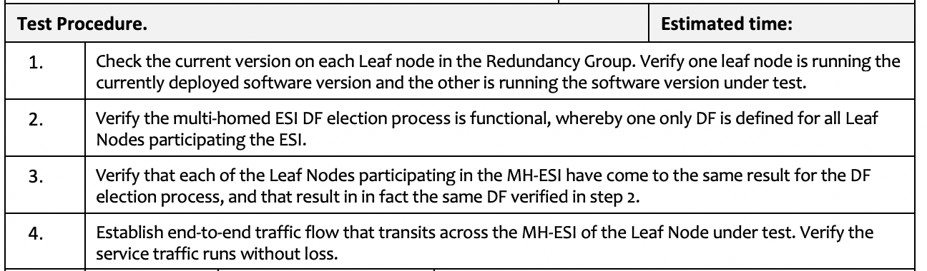
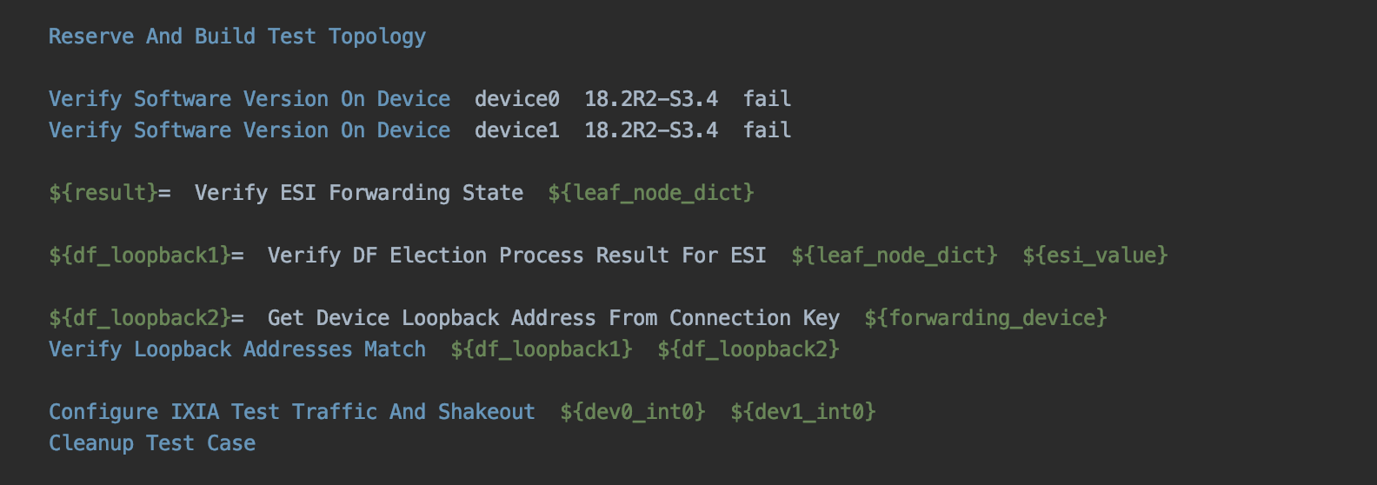
Test Case Structure
Robot Framework – Why?
Easy Transition:
Manual test case document steps
Automated Robot Test Case

Slide 16
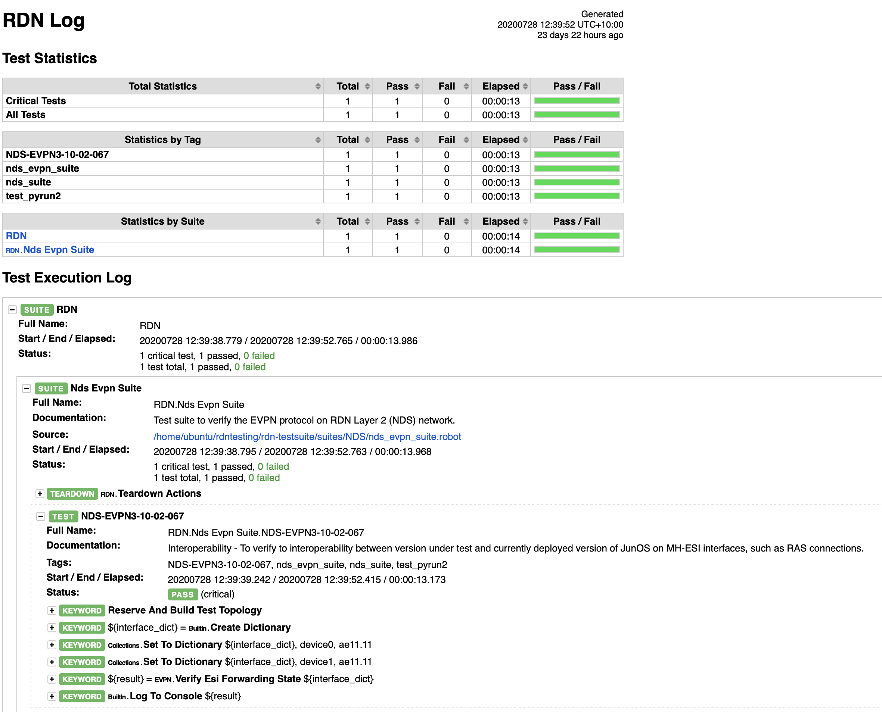
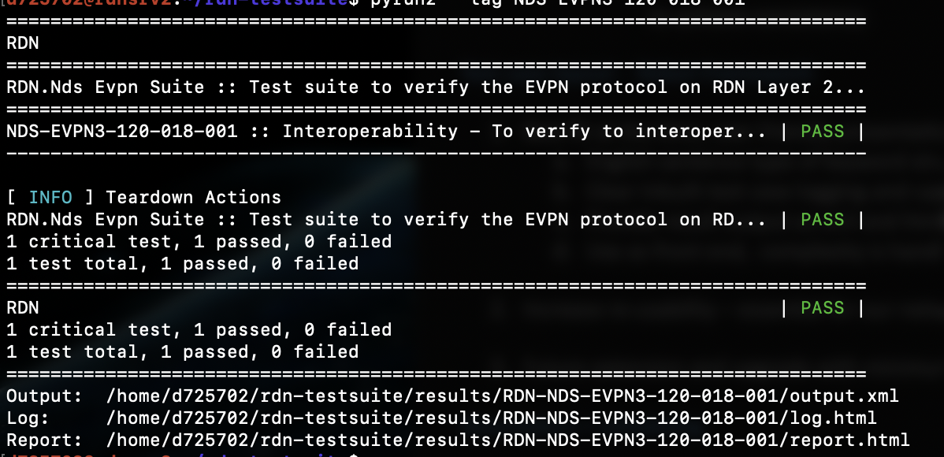
Test Case Structure
Robot Framework – Why?
Logging Capability

Slide 17
Test Case Structure
Robot Framework – Why?
Using only as a front end – Complexity hidden
    Robot was best fit for us when we started, however there are always new and exciting tools are being developed by the community.
    Having the smarts of the tool built in the python backend allows the possibility to extend or “swap out’ the front-end interface for a new tool with minimal effort if something more fit for purpose becomes available.

Slide 18
Automation Principles RESERVATION AND SCHEDULING

Slide 19
Reservation and Scheduling
Our Biggest Challenge!
There is a necessity for lab and resource management
    Found to be our biggest challenge due to the hybrid ‘manual + automation’ nature of shared environment.
    Some challenges include:
        What can be exclusively reserved and what must be shared (Uplinks? Customer links? Whole device?)
        What should be considered exclusive on a device and what should be considered exclusive across the entire lab. (e.g. VLANS, bundle-id on a device and route-targets & route-distinguishers across the whole lab)
        The reservations implemented by the system needs to have visibility of testing resources used by both manual and automation test programs. This is the challenge!

Slide 20
Putting It All Together

Slide 21
Putting It All Together
Our Design Goals:
For a large-scale lab that services many networks, different vendors and different types of testing, how do we address this?
How do we make the developed code re-usable?
How do we implement such a system in an environment where multiple manual test programs are using the same network devices at the same time as automation?
How do we automate the entire testing workflow, not just the execution?
How do we accommodate the nature of test topologies that constantly change?
How do we lower cost and shorten time of test programs without jeopardising testing quality?
Automations Principles:
Inventory
Source of truth
Modularity
Structure
Reservation + Scheduling

Slide 22
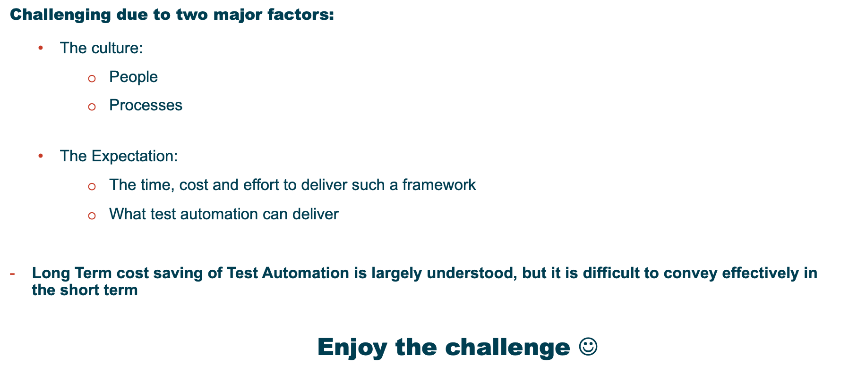
The Cultural Shift

Slide 23
Questions
?

Slide 24
Thank you!

